Slide 1
Ready for Take-Off! Designing ACAA Compliant Self-Service Kiosks
Presented By: Bill Curtis-Davidson Senior Director, Strategic Consulting Services
CSUN 2018 Assistive Technology Conference
March 21, 2018

Slide 2

Ready for Take-Off!
Designing ACAA Compliant Self-Service Kiosks
State of the Industry
Improving the Accessible Kiosk UX
Level Access Client Example
Implications for Airline Programs
Q&A and Resources

Slide 3
State of the Industry

Slide 4
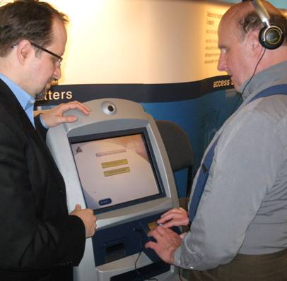

State of the Industry – 10 Years Ago
Technical feasibility but no clear industry regulations or standards
CSUN 2008
IBM’s first accessible air kiosk demo in CSUN exhibit hall
Article in “Check-In” Magazine
Work with IATA CUSS standards development committee
HW and check-in SW vendors, and air carriers, had no agreed-upon standards
Notes:
Photo: Image of a blind man with headset using the Accessible IBM Airline Self-Service Kiosk at CSUN 2008. The person has tactilely located the EZ Access® keypad and is using it and the speech output to complete the check-in transaction.

Slide 5
State of the Industry – 2018
Accessible air kiosks are now becoming more commonplace in U.S. Airports
HW / check-in SW vendors, and air carriers, have agreed-upon standards (DOT & IATA)
Multiple HW vendor solutions
SW / Airline developed solutions
Installed base of units in place
Still much room for UX improvement – e.g. Speech
Notes:
Various installed airline kiosks from (Left to Right, Top to Bottom): United Airlines, Southwest Airlines, American Airlines, Alaska Airlines, Frontier Airlines

Slide 6
State of the Industry – Looking to Future
Where do we go from here?
2018
Programs
2017 –
Increasing need for formal digital accessibility programs
Kiosks
12-Dec-2016 25% new kiosks
Monitor & Maintain Kiosk Accessibility
12-Dec-2022 25% all kiosks
Websites
12-Dec-2015 Core services
12-Dec-2016 Entire website
Monitor & Maintain Web Accessibility
Notes:
So where do we go from here?
Websites: Airlines have worked to make their websites meet ACAA requirements beginning with core services (12-Dec-2015) and then entire websites (12-Dec-2016). Now, airlines must monitor and maintain accessibility of those sites.
Kiosks: On the Kiosk side, airlines have worked to begin to put in place their first publicly available kiosks beginning with new installations happening after 12-Dec-2016. Now, airlines must monitor and maintain accessibility of those kiosks, expanding to ensure that 25% of all kiosks are accessible by 12-Dec-2022.
Programs: Over the last year (2017) – given this need to monitor and maintain web and kiosk accessibility - we’ve seen an increasing need for digital accessibility programs.

Slide 7
Improving the Accessible Kiosk UX

Slide 8
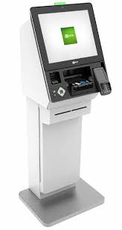
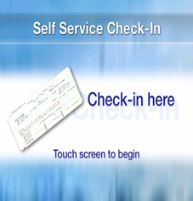
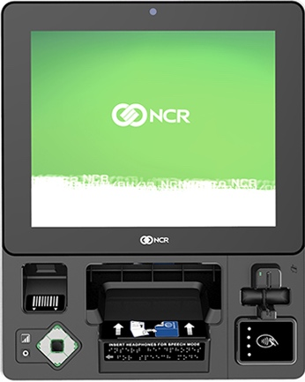
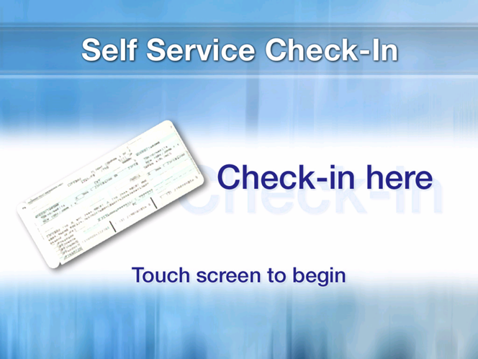
Accessible Kiosk Design & UX – Part 1
Designing ACAA Compliant Self-Service Kiosks
2
Find Audio Jack & Plug In Headset
On the accessibility keypad (HW), adjust audio as needed
3
Listen to App Overview
Press down button on access keypad
1
Locate Kiosk
Graphics: Bill Curtis-Davidson, NCR, Storm Interface
Notes:
First step is to locate the accessible kiosk unit in the airport
Second step is to find the audio jack and plug in the headset on the accessibility keypad. The user can adjust the volume of the speech output as needed.
Third step is to listen to an application overview, then pressing down (or other) key on the accessbiility keypad to begin the transaction.

Slide 9
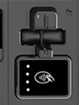
Accessible Kiosk Design & UX – Part 2
Designing ACAA Compliant Self-Service Kiosks
4
Find Your Reservation
Find credit or loyalty card slot and insert card to find your reservation. Could also be a scan of itinerary bar code.
6
Enter Reservation Confirmation
System not able to find reservation using card so user utilizes access keypad and speech output to enter their record locator into a text field.
5
Interstitial Screen
System attempts to find the user’s reservation, user asked to wait (on-screen, speech)
Graphics: Bill Curtis-Davidson, NCR, Storm Interface
Notes:
The fourth step is to ask the user to find the loyalty or credit card slot and swipe their card to find their reservation. This could also be a scan of a printed or mobile barcode.
Fifth step is to view an interstitial screen, where a "please wait" message is displayed while the system attempts to find the user's reservation.
The sixth step is to enter a reservation confirmation number. This is required because the system was not able to find the reservation using the card swiped in the reader. So, the user utilizes accessibility keypad and speech to input an alphanumeric record locator.

Slide 10
Accessible Kiosk Design & UX – Part 3
Designing ACAA Compliant Self-Service Kiosks
9
Review Seat Assignments
User employs HW access keypad/speech to read complex table listing multiple passengers’ seat assignments. Options to change seats could also be presented… When user completes check-in they will retrieve printed boarding pass.
7
Select Passengers Checking in Now
Multi-passenger reservation found and passengers listed with checkboxes. User employs HW access keypad and speech output to select one or more passengers.
8
Review Flight Segments
User employs HW access keypad and speech output to read simple table listing 2 flight segments.
Graphics: Bill Curtis-Davidson, NCR, Storm Interface
Notes:
The seventh step is to select the passenger in the located reservation who are checking in now. To do so the user utilizes the accessibility keypad and speech output to select/de-select checkboxes for each passenger in the reservation.
The eighth step is to review the flight segments by reading each row in a simple table using speech output.
The ninth step is to review seat assignments for people checking in now for each flight segment. The user employs the accessibility keypad (HW) and speech output to read a complex table listing multiple passengers’ seat assignments. Options to change seats could also be presented… When user completes check-in they will retrieve printed boarding pass.

Slide 11

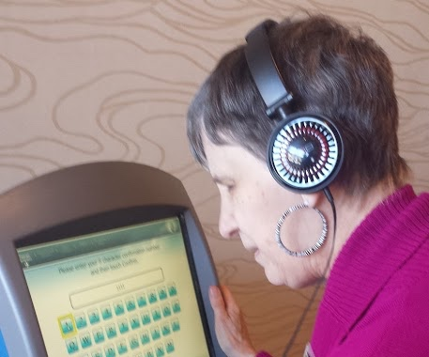
Speech + Keypad UX: Key Interactions
Designing ACAA Compliant Self-Service Kiosks
Activation & Volume
Initial Orientation
Navigate, Focus, Select
Top/Bottom Screen
Screen Transitions
Replay Instructions
Cancel Transaction
Notes:
Descriptions of graphics
Activation & Volume: Headset being connected to an audio jack on an EZ Access navigation keypad
Initial Orientation: Image of blind woman using headphones and an airline check-in kiosk
Navigate, Focus, Select: Screen shot showing user navigating among, focusing on, and selecting UI elements using speech and EZ Access Keypad
Top/Bottom of Screen: Screen shot with audio icons for "top" and "bottom" of screen
Screen Transitions: Transition screen with "Please wait" message
Replay Instructions: Screen shot of kiosk showing user requesting replay of instructions via long press of the Select Button on the EZ Access keypad
Cancel Transaction: Screen shot of kiosk with cancel transaction warning

Slide 12
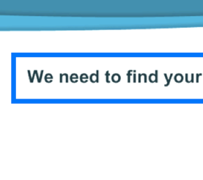
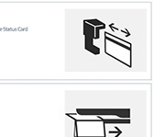
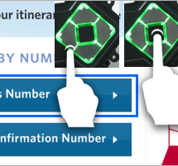
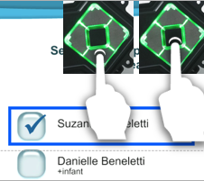
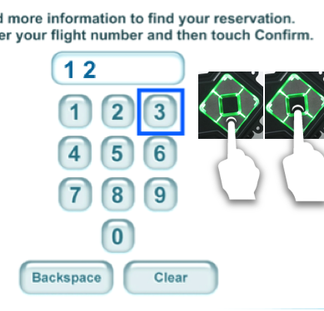
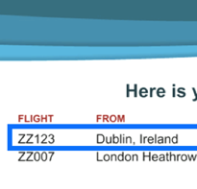
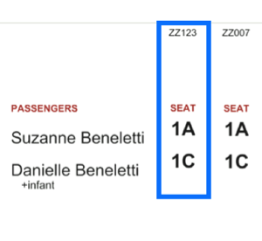
Speech + Keypad: Element-Level Interactions
Designing ACAA Compliant Self-Service Kiosks
Instructional Text
Meaningful Images
Buttons
Checkboxes
Text Inputs & Keys
Simple Tables
Complex Tables
Notes:
Descriptions of graphics
Instructional Text: Screen shot showing focus indicator around instructional text.
Meaningful Images: Diagrams showing proper way to insert or swipe a loyalty or credit card in two different style card readers (one horizontal, one vertical)
Buttons: Screen shot showing use of EZ Access keypad to move focus onto button and select the button after understanding its purpose
Checkboxes: Screen shot showing use of EZ Access keypad to move focus onto checkbox and select / de-select the checkboxes after understanding the checkbox labels.
Text Inputs & Keys: Screen shot showing use of EZ Access keypad to navigate an on-screen keypad and enter alphanumeric text into a text input on screen.
Simple Tables: Screen shot showing simple table listing a few flight segments with table column headers like "Flight", "From", etc.
Complex Tables: Screen shot showing complex table with seat assignments for multiple passengers checking in now, and multiple flight segments.

Slide 13

Urgent Areas for Accessible Kiosk Design
Designing ACAA Compliant Self-Service Kiosks
Design requirements
Integrating Accessibility into Dev Process
Consistency of design and UX
Blended internal / vendor teams

Slide 14
Level Access Client Example

Slide 15

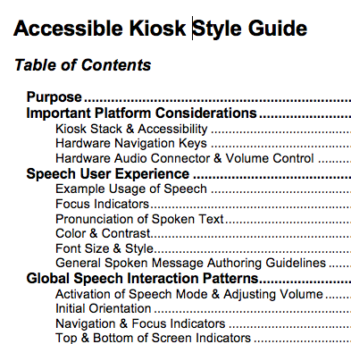
Level Access Client Deliverables
Designing ACAA Compliant Self-Service Kiosks
Requirements Workshop & Report
Kiosk Stack Requirements
& Speech Design
Initial Audit – Pre Full Development
Development Consulting & Full Audit w/ PWDs
Accessible Kiosk Style Guide
Photo credits (left-to-right): (1) Created by Katemangostar - Freepik.com; (2) IATA CUSS Specification and Accessibility icon by mikicon from the Noun Project (Modified); (3) Created by Freepik.com; (4) Bill Curtis-Davidson; (5) Level Access.
Notes:
Level Access worked with one of the larger U.S. domestic airlines to enable their development of first release of their accessible self-service kiosk, which has begun deployment in certain airports. Some services that Level Access provided this client included:
Requirements Workshop & Report: Level Access conducted a workshop with the kiosk product managers, designers, developers and QA testers. In this workshop, we reviewed the components of the airline’s kiosk stack (Hardware, Platform SW, Check-In App) and discussed approaches for meeting ACAA kiosk accessibility compliance requirements. After the workshop, a Report was completed to prepare the integrated team for work to come.
Kiosk Stack Requirements & Speech Design: Level Access prepared an outline of the full kiosk stack requirements including some notations to document how the airline carrier was planning to meet the requirements. Level Access also discussed various aspects of speech user interaction using the airline carrier’s selected hardware.
Initial Audit - Pre Full Development: Level Access performed an initial audit of the working development unit, including a review of the hardware and software design, speech interaction, etc. This audit included both technical assessment as well as use cast testing including persons with disabilities.
Development Consulting & Full Pre-Release Audit: After the initial audit, Level Access consulted with the airline’s kiosk development team as needed, to help them address accessibility challenges identified during the initial audit. Before the kiosk’s final release, Level Access performed a second, full-audit of the release version, onsite at an airport.
Accessible Kiosk Style Guide: To help this airline client achieve accessible kiosk consistency, Level Access created an Accessible Kiosk Style Guide. This guide should help the company as it continues to ensure its self-service kiosks comply with ACAA.

Slide 16
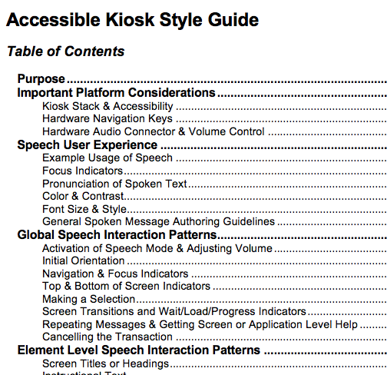
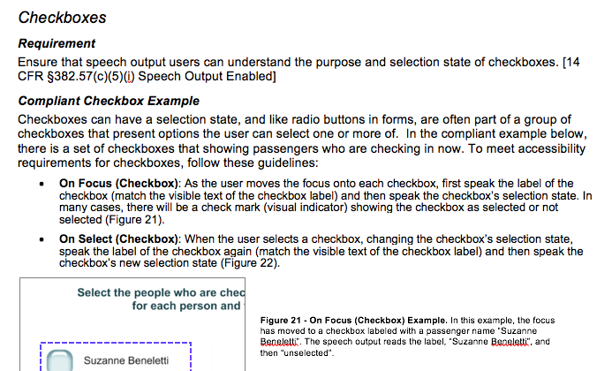
Accessible Kiosk Style Guide
Designing ACAA Compliant Self-Service Kiosks
Notes:
The Accessible Kiosk Style Guide that Level Access created for this airline client covers topics like:
Important platform considerations;
Speech user experience;
Global speech interaction patterns (e.g. activation of speech mode and adjusting volume, initial orientation, navigation and focus indicators, making a selection, top and bottom of screen indicators, screen transitions, help/repeating instructions, cancelling the transaction); and
Element-Level Speech Interaction Patterns (e.g. screen titles/headings, instructional text, etc.).
An example of guidance for checkbox-type controls is shown here. Each guidance element in the Style Guide provides: requirement, mapping to ACAA requirements, compliant figure(s) / example(s), and a caption describing each figure/example.

Slide 17
Implications for Airline Programs

Slide 18
Airline Kiosk Life Cycle Implications
Designing ACAA Compliant Self-Service Kiosks
Designing for ACAA compliant websites and kiosks requires a programmatic effort to reduce risk and ensure positive UX.
Requirements
Include Accessibility
Checklists for hardware and software
Design
Style Guide
Consult PWDs
Development
Follow Best Practices
QA/Testing
Release
Accessibility Tests by Need
Features Doc
Accessible Support
Design Comps
Test Prototypes and Access Features
Use Case Tests w/ PWDs
Speech Scripts
Pre-Flight Comm
Image Credits (From Left): (1) Created by Freepik; (2) GA Institute of Technology; (3) Created by Freepik; (4) Created by Makyzz (Freepik.com); (5) Created by Photoroyalty (Freepik.com)

Slide 19
Airline Digital Accessibility Implications
Designing ACAA Compliant Self-Service Kiosks
Organization | Implications | Solutions (Web and Kiosk)
Compliance | Need to ensure compliance policies include mandates for accessible web / kiosk design to support ACAA compliance. | Accessibility Policy
Marketing | Need to also ensure the airline communicates its policy externally. | Accessibility Statement
Procurement | Need to ensure that third party suppliers involved in web or kiosk development understand the airline’s ACAA compliance requirements and provide solutions to meet them. | Accessibility Procurement & Contract Policy and Language
Technology Development | Include accessibility requirements, maintain accessible design, follow best practices, engage PWDs in development of new versions, test for conformance to ACAA requirements. | Accessibility Checklists Accessibility Integration in Life Cycle Accessibility Testing Process/Platform Accessibility Style Guides
Operations & Support | Ensure accessible website and kiosk features are documented for customer self-service and support. | Accessibility Features Documentation Accessible Customer Support

Slide 20
Q&A and Resources

Slide 21

Resources
Designing ACAA Compliant Self-Service Kiosks
Cornell Legal Information Institute, 14 CFR § 382.57 What accessibility requirements apply to automated airport kiosks?
Kiosk Industry, ADA Whitepaper 2017
Level Access, DOT Reaches Agreements with Airlines over Inaccessible Airport Kiosks, Websites
Level Access Blog, Air Carrier Access Act (ACAA) posts

Slide 22





Thank You
Designing ACAA Compliant Self-Service Kiosks
Contact
Follow Us
@LevelAccessA11y
Bill Curtis-Davidson
Sr. Director, Strategic Consulting Services
bill.curtis-davidson@levelaccess.com
Level Access
Level Access
Level Access Blog
Slide Deck Available for Download at: https://www.levelaccess.com/csun18/

